Slide 1
NYC IGO Convention 2023 Borough Recommendation
Terry Barnett & David Gamarra

Slide 2
Introduction
This project explored three preferences for a group of 500 international delegates who would be working on a 2-year project in New York City. The group prioritized amenities of equal importance: entertainment lounges, electric vehicle (EV) charging stations, and the top 10 chain grocery stores. The group also named Manhattan, Queens and Brooklyn as the boroughs that they prefer to live in for the duration of the project. We used grocery and lounge data from Yelp API calls as well as EV data from a New York State government website. This analysis seeks to gain preliminary insights about which NYC borough has the most offerings of amenities for the delegation.

Slide 3
The CSV files were read by pandas to create and wrangle three separate dataframes

Slide 4
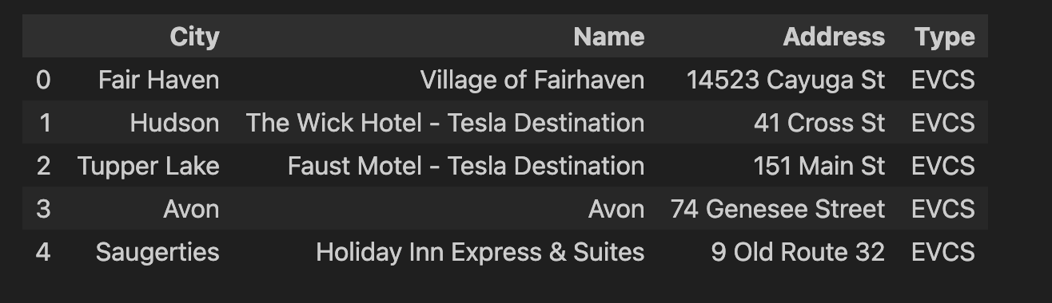
EVCS Dataframe

Slide 5
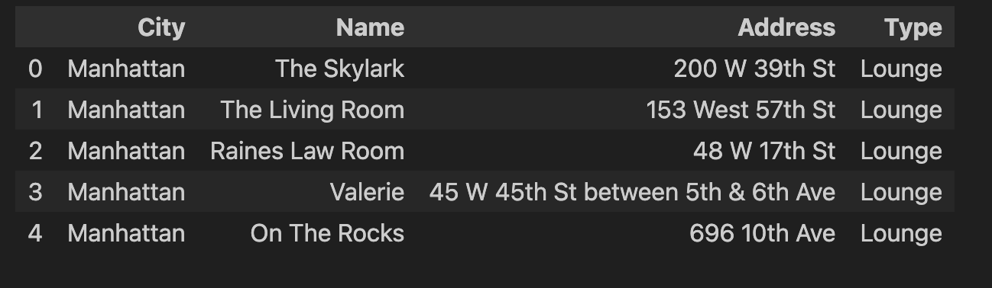
Lounge Dataframe

Slide 6
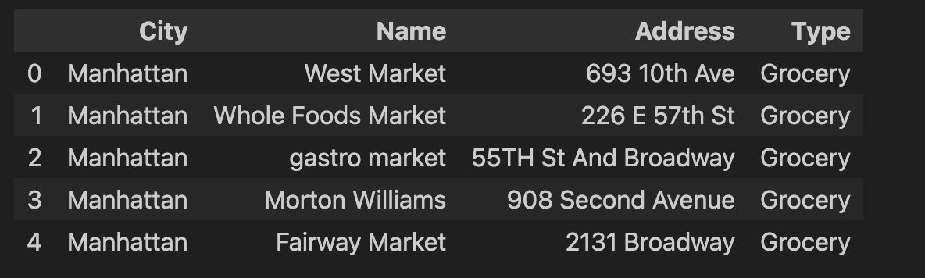
Grocery Dataframe

Slide 7
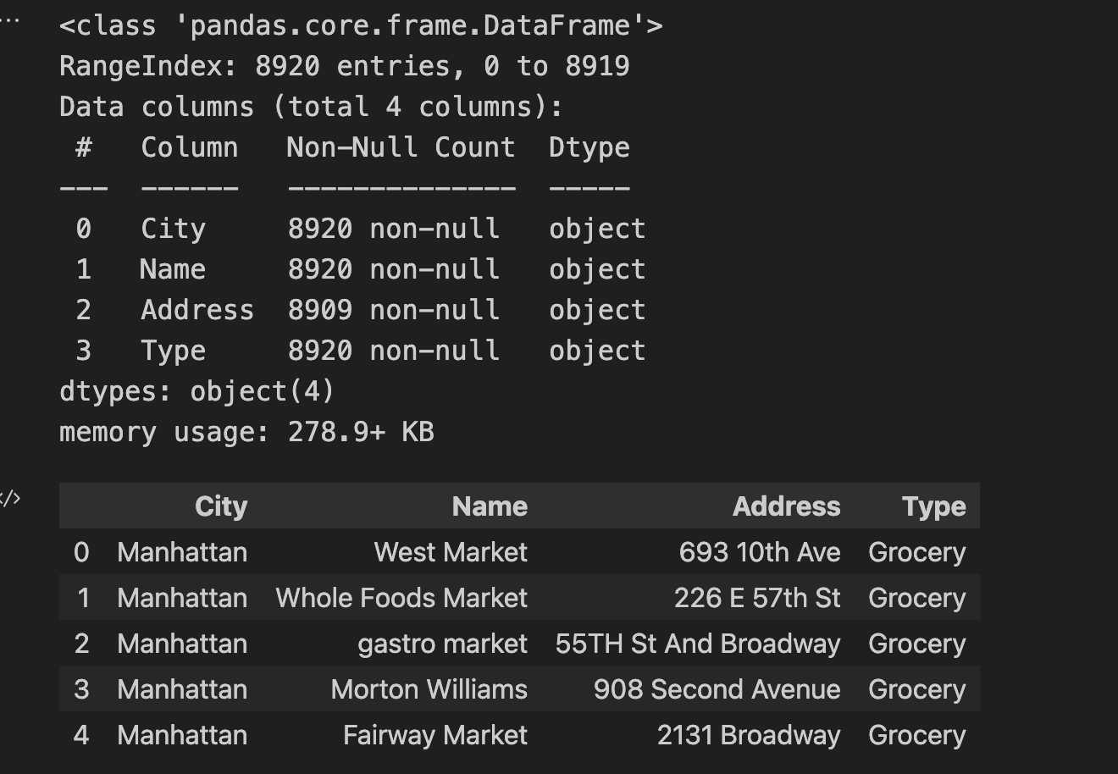

Clean Stacked Dataframe using concat, dropna & dropduplicates then get info & check length

Slide 8
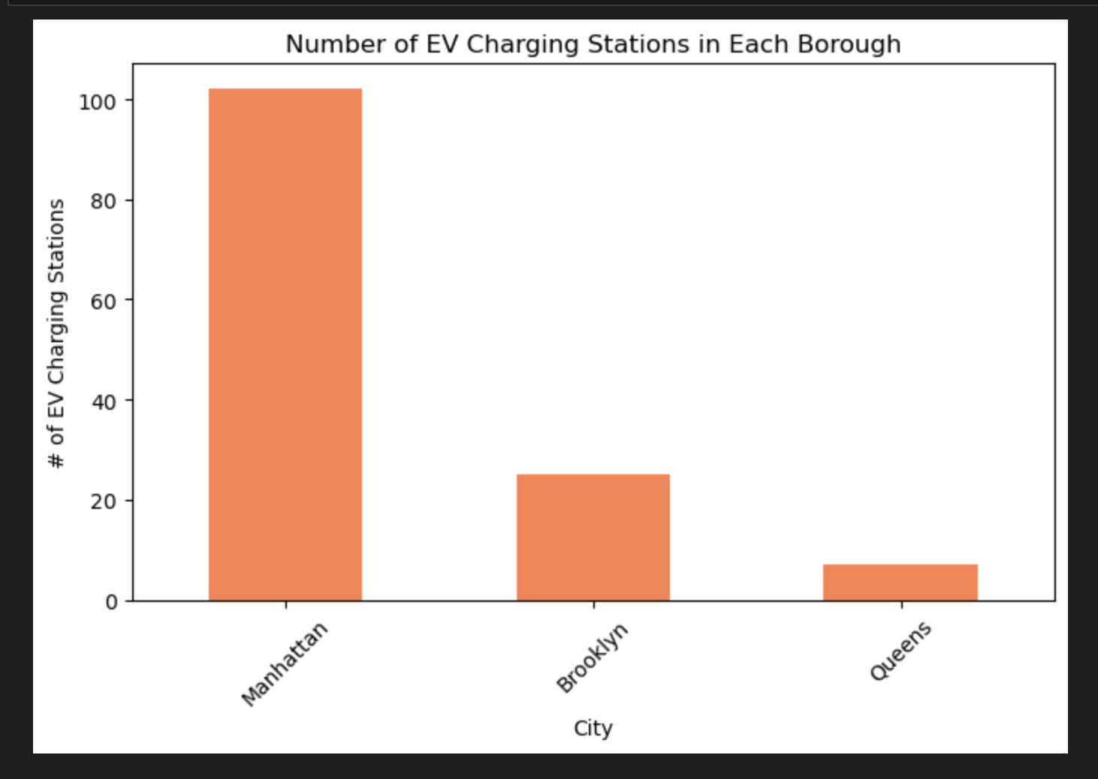

Slide 9
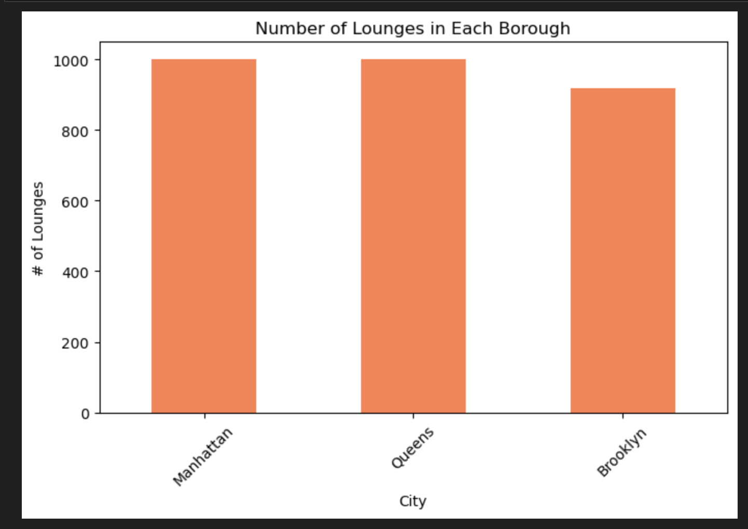

Slide 10
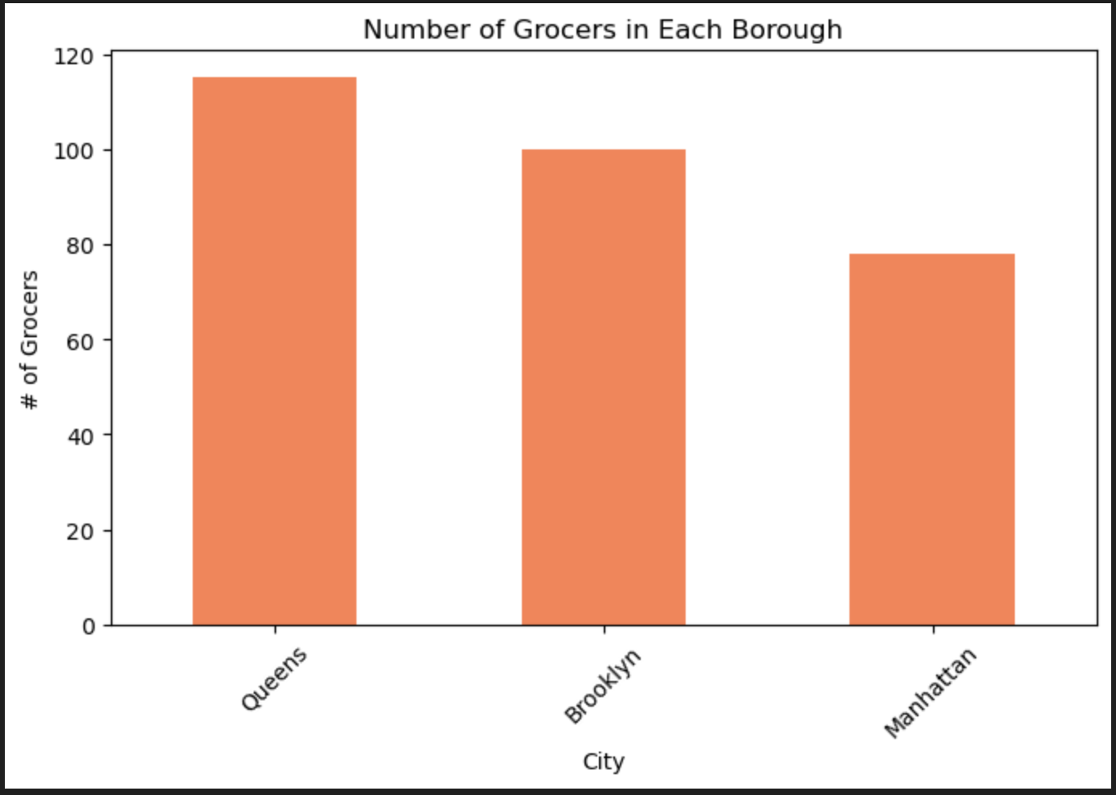

Slide 11
Manhattan is the borough with the most combined counts (1179) for EVCS, lounges, and groceries.

Slide 12
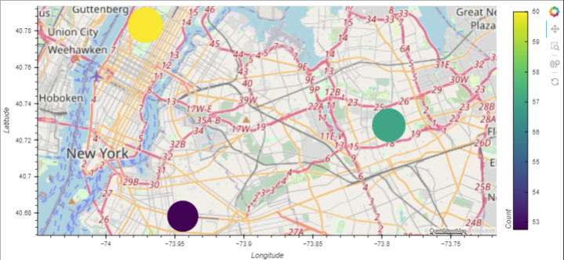

Slide 13
Limitations and Recommendations for Further Investigation
EVCS
Check to see the exact locations of EV charging stations to see if another borough is equally or more convenient that Manhattan to access the amenity.
LOUNGES
Check the NYC Dept of Building pax limits for lounges, as well as each establishment's size and policy on large group meet-ups.

Slide 15
Thank You

